Slide 1
Robert Lawrence Friedman
The Healing Power of the Drum – Changing Lives
We are living in very troubling times where what is needed now is hope and love. The work that I and others in this field are doing are helping to lift the planet to a higher state of consciousness in body/mind and spirit. Through the process of rhythm-based therapeutic protocols that I will be discussing, various outcomes are achieved including, awakening the heart, awakening the universal connection with others, and awakening and revitalizing the spirit.

Slide 2
Changing Lives
The path that I have chosen for this project is perhaps, unconventional, as it will include a creative expression couched in research, including poetry, photographs, and videos of my experience on this path for the past thirty-six years. By its completion, it is my hope that everyone who reads this paper, will be drawn to including a drum in their spiritual journey.
In the past 36 years, I have traveled to 10 countries, worked with populations ranging from burn survivors to women with cancer, work with hemophiliacs, children with terminal cancer in the Dominican Republic. I have trained addictions counselors, Chaplains in North Carolina, and healthcare workers how to use the drums for health, wellness and spiritual development.
Video with England with physical therapists.

Slide 3
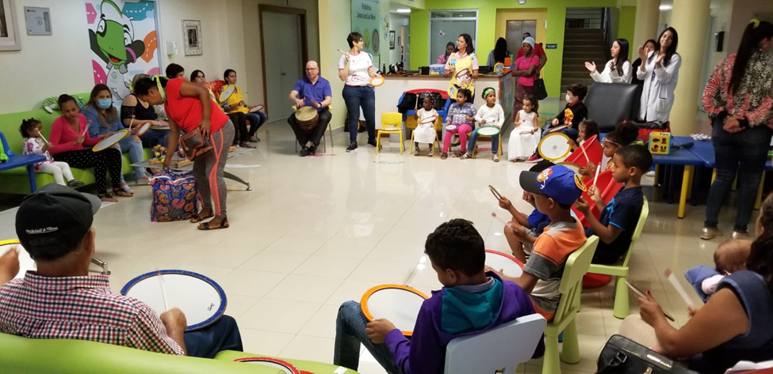
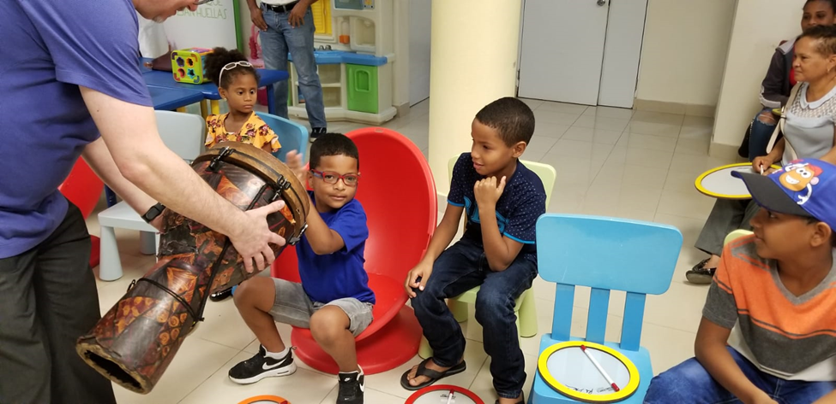
Dominican Republic Drumming for Kids with Cancer

